Slide 1
EEG-Based Classification of Psychiatric Disorders
Cameron Young

Slide 2
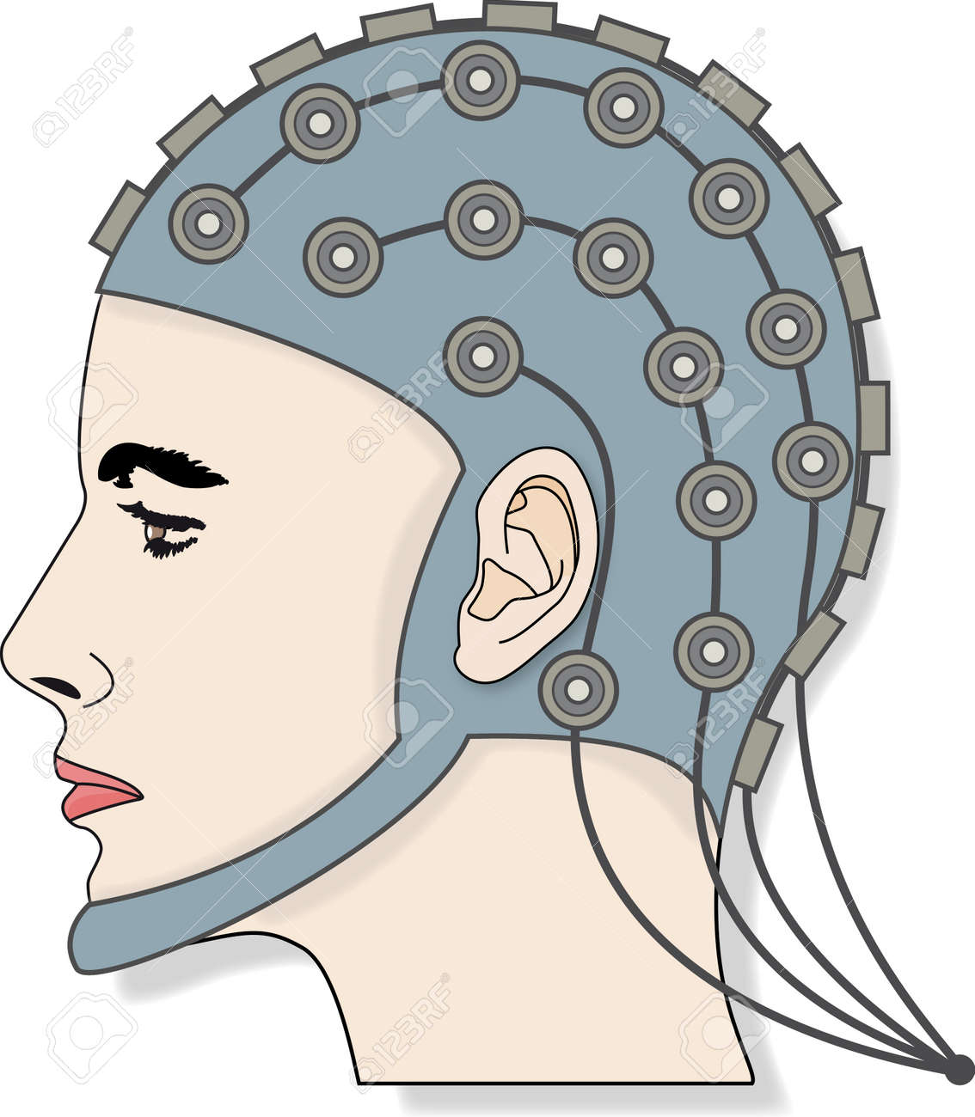
EEG
Non-invasive brain test that records the brain’s electrical activity using electrodes

Slide 3
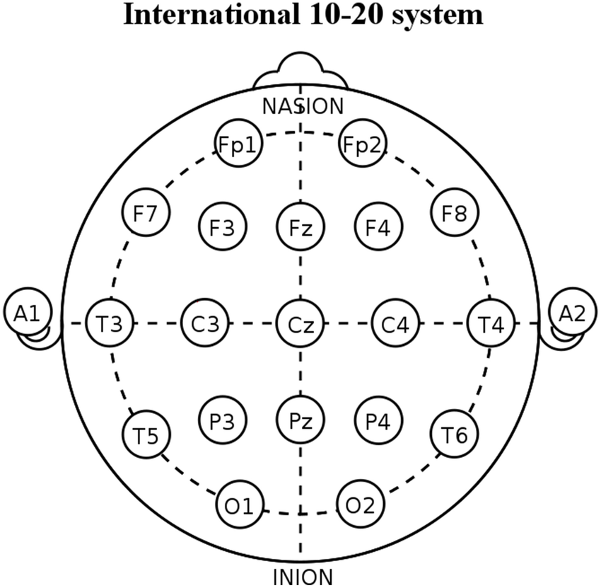

Slide 4
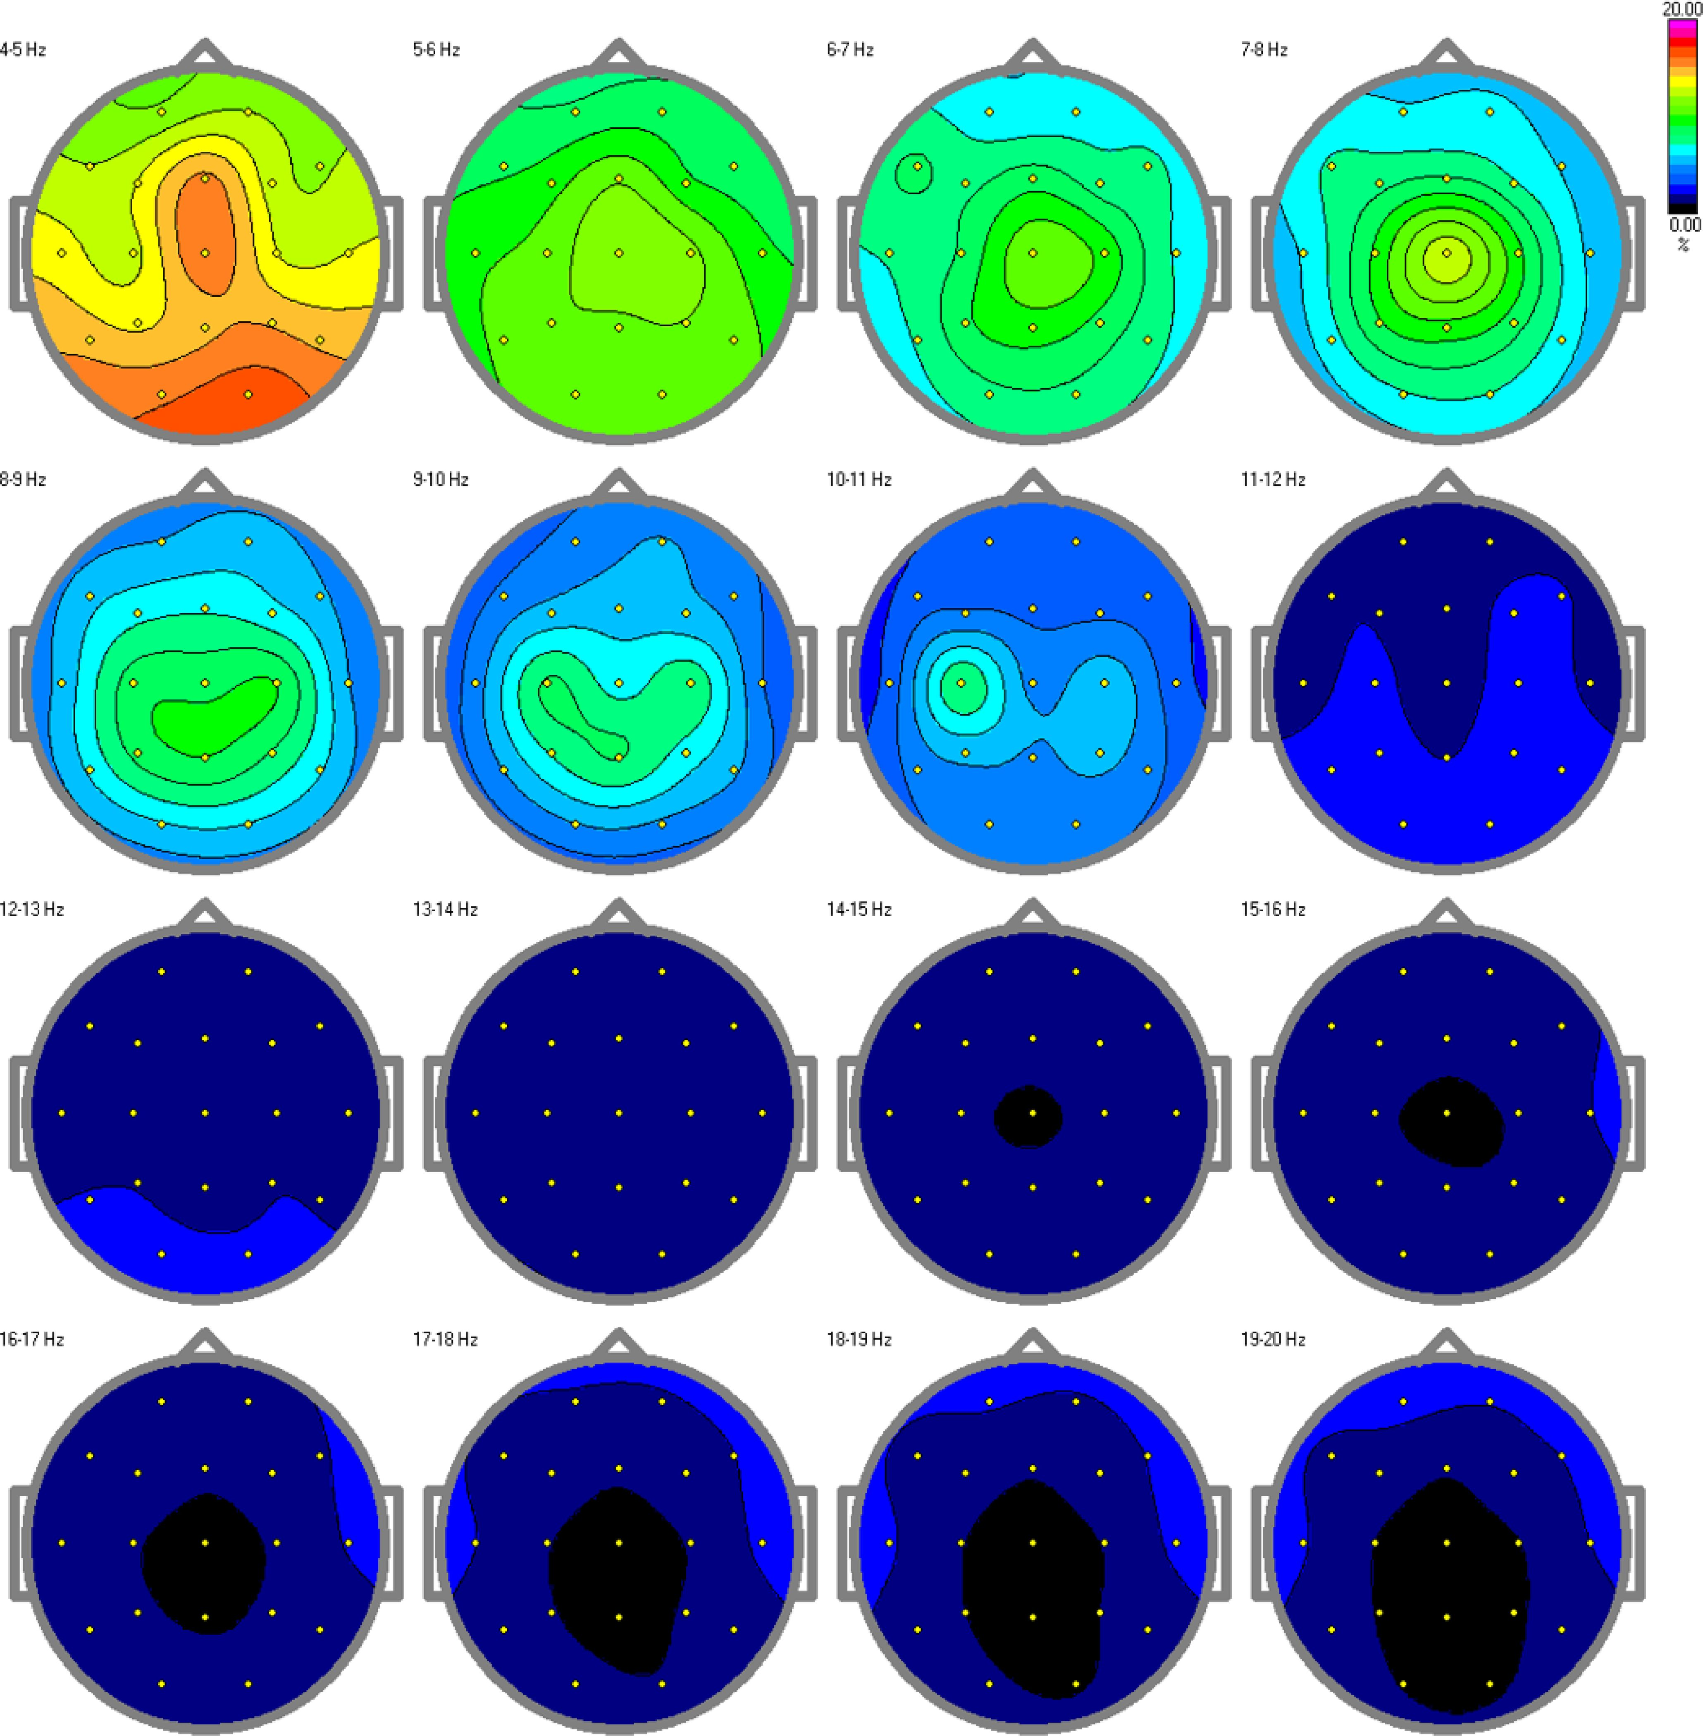

Slide 5
Context
Mental Health illness is one of the most prevalent challenges of our time.
~20% of adults are estimated to battle mental health conditions. (1 in 5)
Mental health illness can seriously increase risk of disability, pain, loss of freedom, or death.
Current diagnosis relies on subjective clinical interviews, not biomarkers. EEGs are used as a helpful tool in diagnosis.

Slide 6
The Dataset
Data recorded from EEGs, along with diagnosed mental illness including:
Addictive Disorder
Anxiety Disorder
Mood Disorder
Obsessive Compulsive Disorder
Trauma and Stress Related Disorder
Schizophrenia
Data contains:
6 Psychiatric Disorders + Healthy Controls
1149 Features (114 Absolute Power | 1,026 Coherence)
945 Subjects (919 after cleaning data)

Slide 7
EEG Features Explained
EEG Features are generally associated with certain characteristics
My dataset contains 1,140 features: Absolute Power (Activity level in each band) and Coherence (connectivity between the brain regions)
Delta (>4 Hz) | Deep sleep waves. Dominant rhythm in infants. (Slowest waves)
Theta (4-8 Hz) | Creativity, Intuition, Daydreaming. Strong during focus, mediation, and prayer.
Alpha (8-13 Hz) | Relaxed state (Not aggitated, not drowsy). Aids in ability to mentall coordinate, Alpha is common for a person in an alert state, but not actively processing information.
Beta (13-30 Hz) | Dominant frequency during eyes open, listening, thinking, analyticaly problem solving, judgement, deicison making, processing information (Faster waves)
Gamma (>=30 Hz) | Found in all areas of brain, associated with good memmory, simultaneous information processing, and higher processes.
Coherence (COH) | Refers to how synchronized brain regions are. Measures connectivity between electrode pairs. Crucial for understanding brain communication.

Slide 8
Datascience

Slide 9
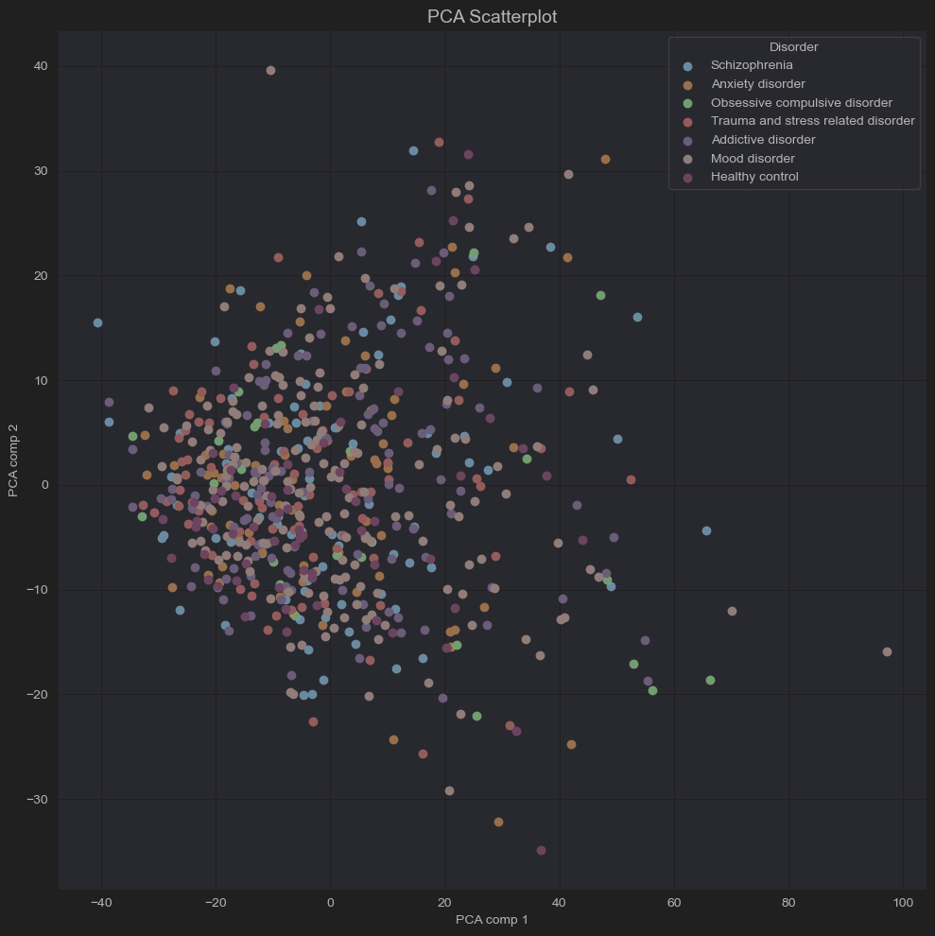
KNN
Accuracy:
30% | 30.7% (PCA)
A bit better than guessing.

Slide 10
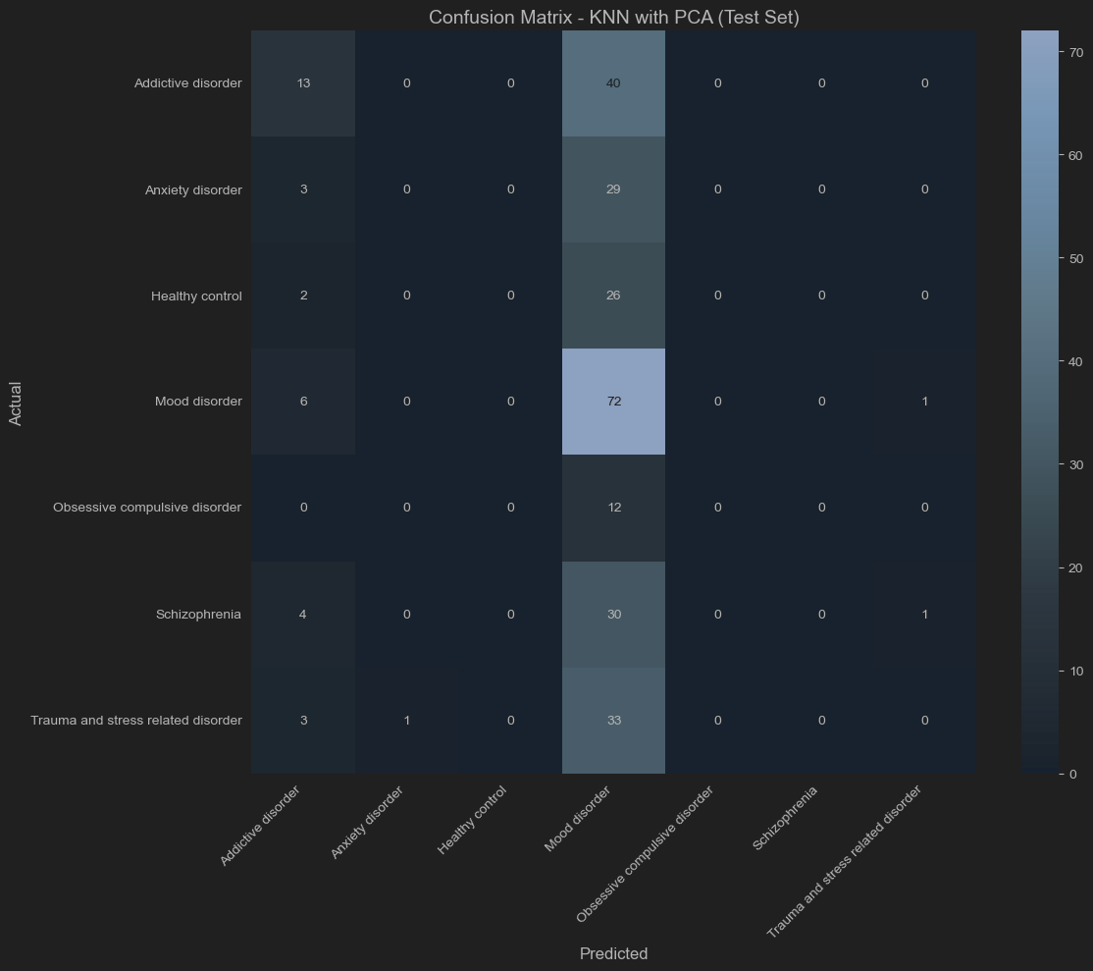

Slide 11
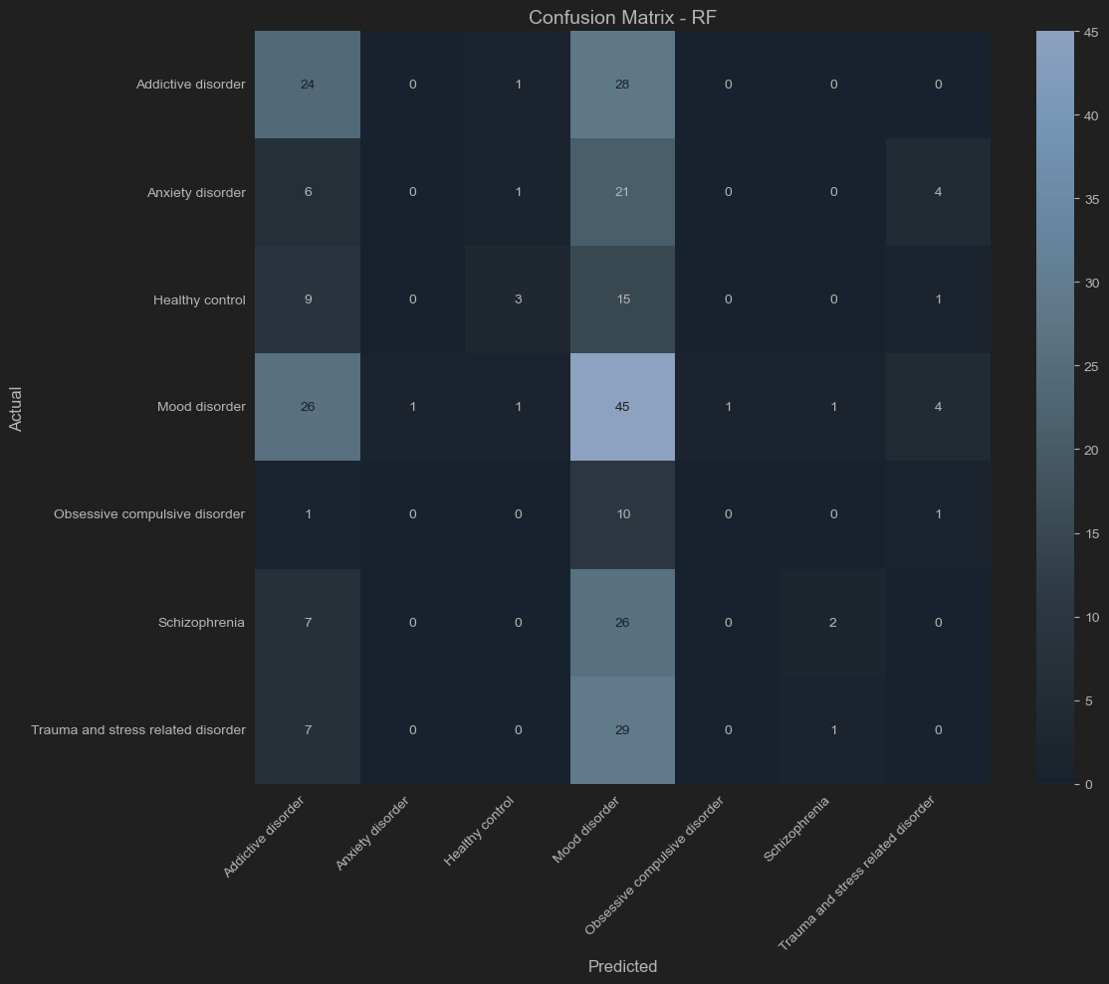
Random Forest
Accuracy:
32.1%
Slightly better than KNN

Slide 12
Problem
There are too many features and disorders to work with, especially because symptoms overlap.
Binary Classification is a much better approach.
I chose to use Random Forest for the following.

Slide 13
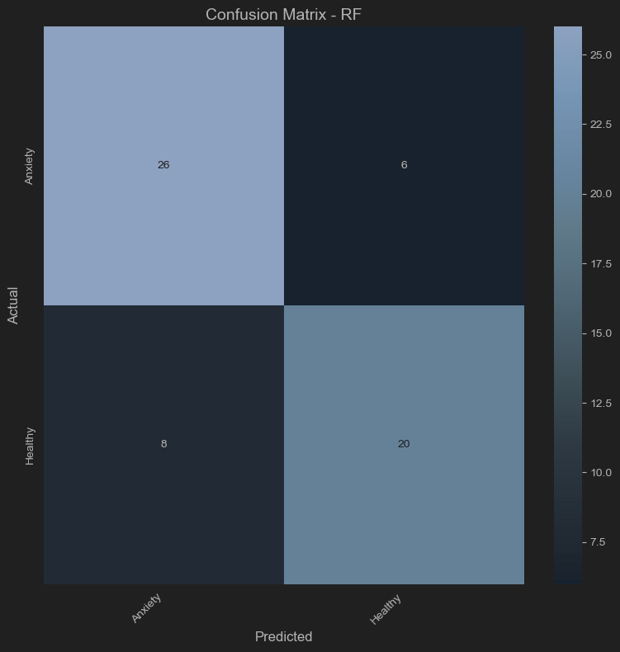
Anxiety vs Healthy
Accuracy:
69.7%

Slide 14
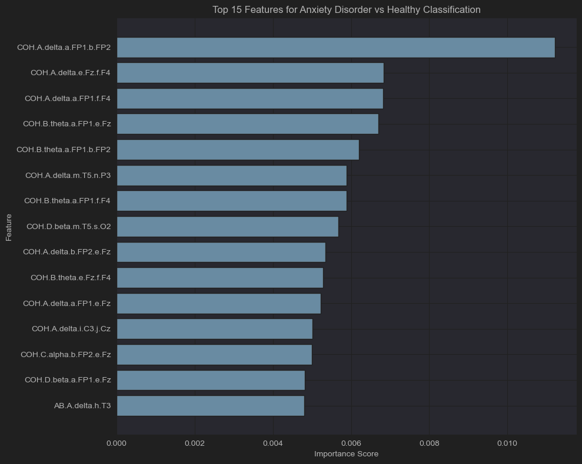
Feature Importance
Dominant frontal delta/theta coherence
Communication deficits in the areas responsible for regulating emotions

Slide 15
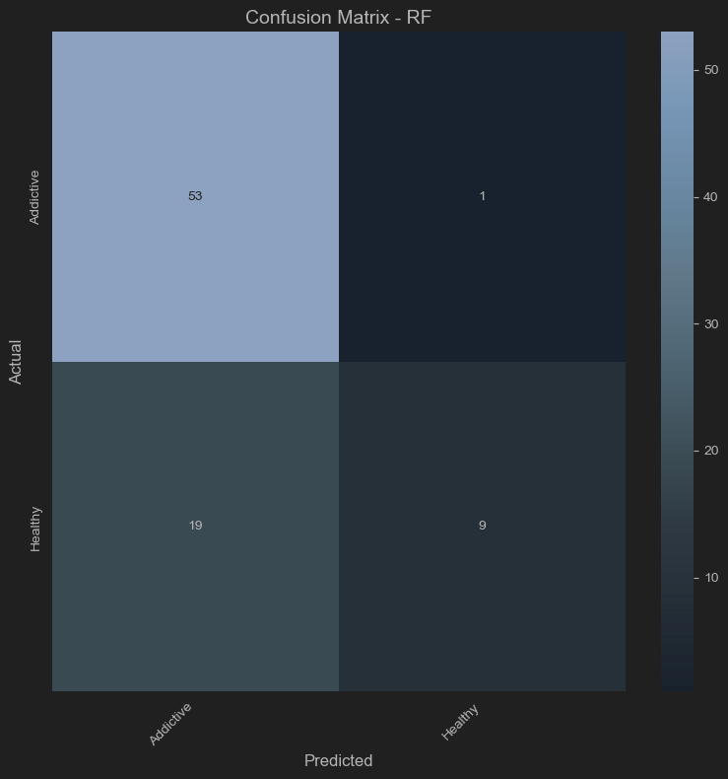
Addictive vs Healthy
Accuracy:
70.7%
Class imbalance
Stratified data

Slide 16
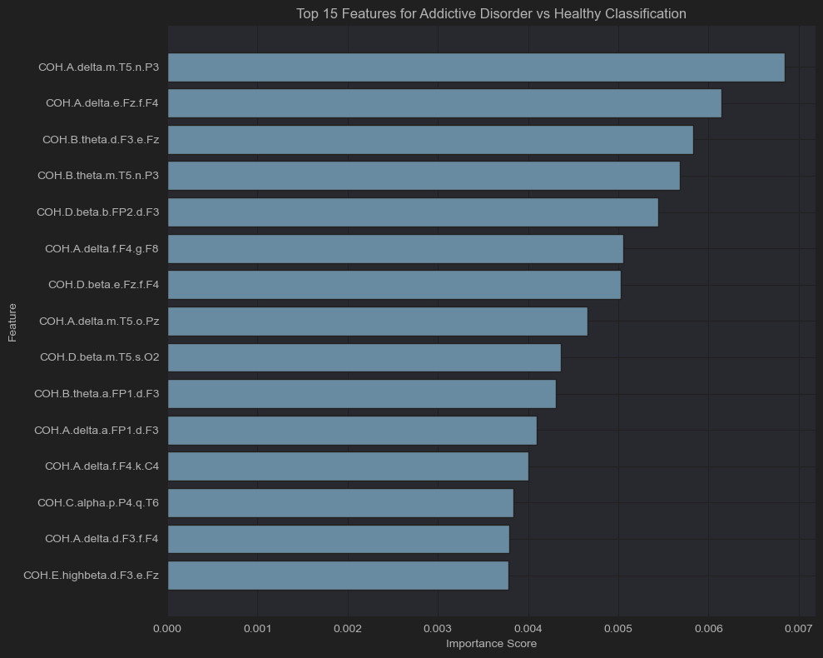
Feature Importance
Delta/Theta/Beta
Coherence
Connectivity dysfunction across bands

Slide 17
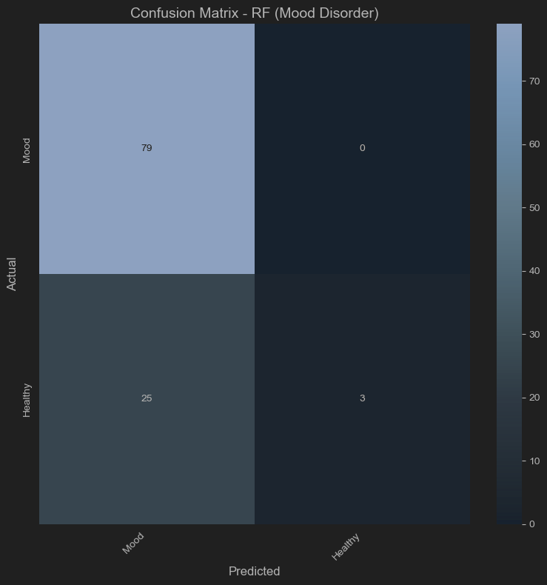
Mood vs Healthy
Accuracy:
74.1%
Class imbalance
Stratified data
Class weight = Balanced

Slide 18
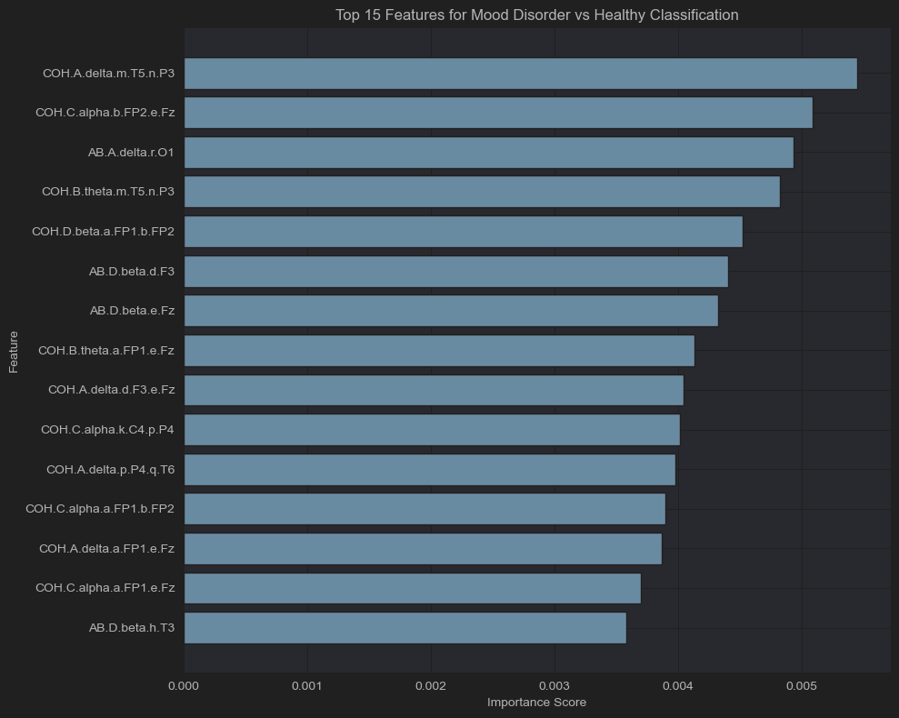
Feature Importance
Delta temporal-parietal / Alpha coherence
Frontal alpha connectivity disrupted

Slide 19
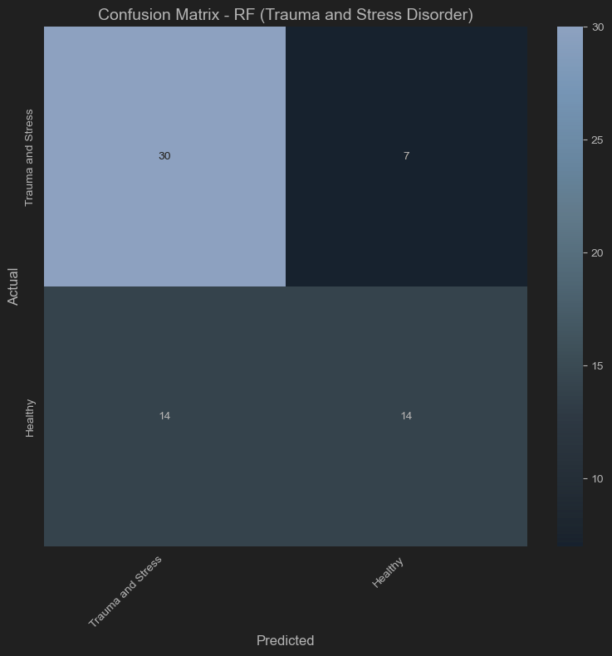
Trauma and Stress vs Healthy
Accuracy:
70.7%
Better class balance

Slide 20
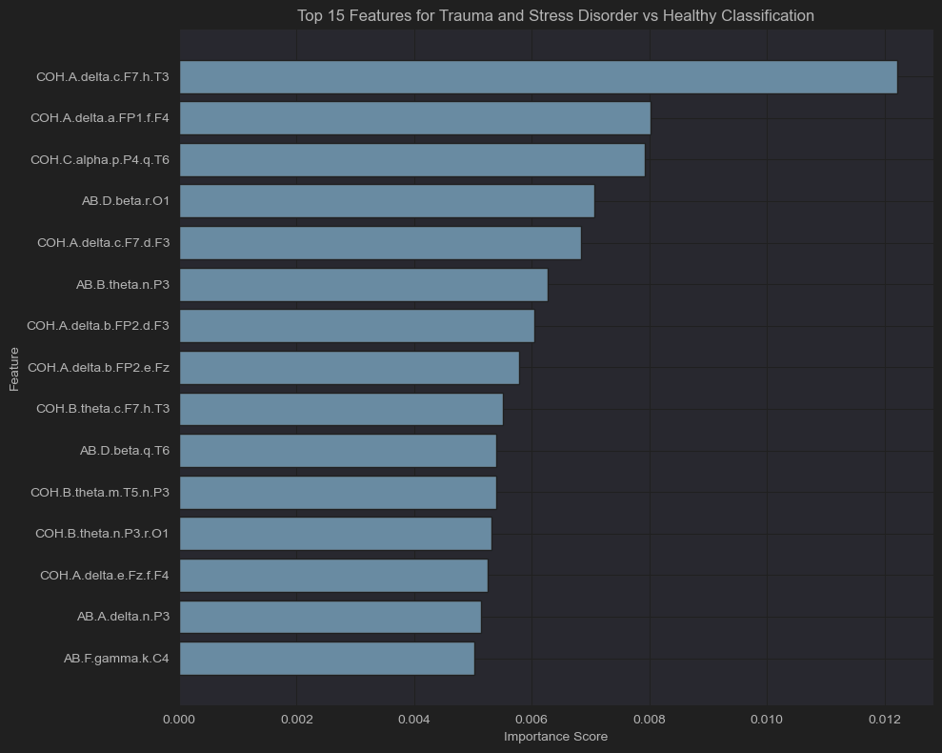
Feature Importance
Delta/Beta/Gamma
Frontal alpha
Mixture of slow and high frequency waves

Slide 21
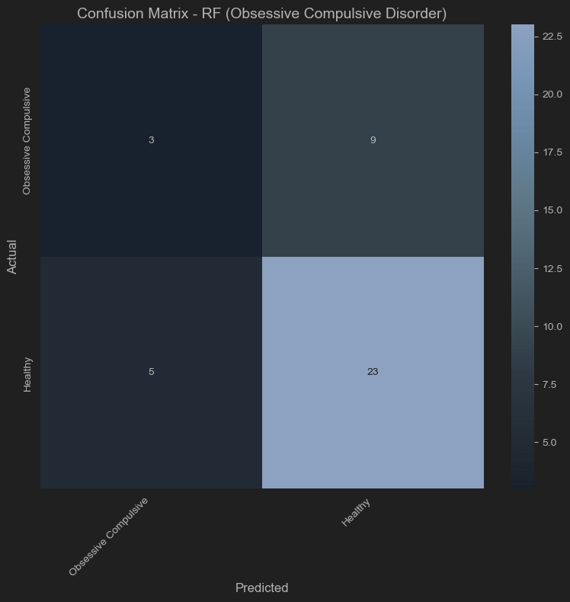
Obsessive Compulsive vs Healthy
Accuracy:
73.1%
Better at predicting when someone does NOT have this condition

Slide 22
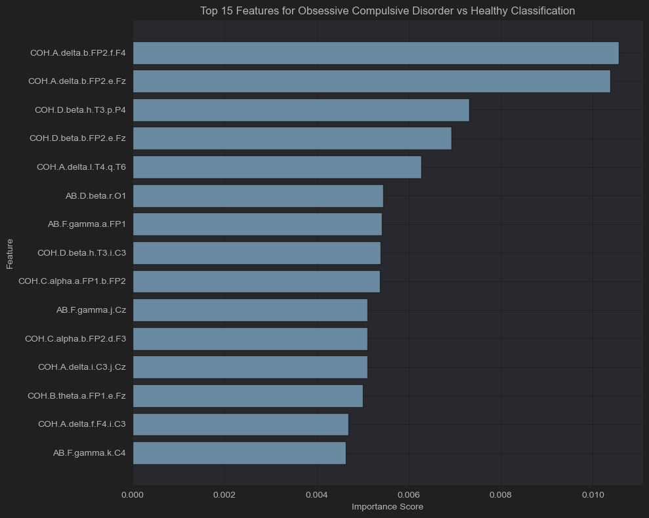
Feature Importance
Delta Coherence / Beta/Gamma Power
High-Frequency Activity in frontal regions.
Characterize healthy brain activity

Slide 23
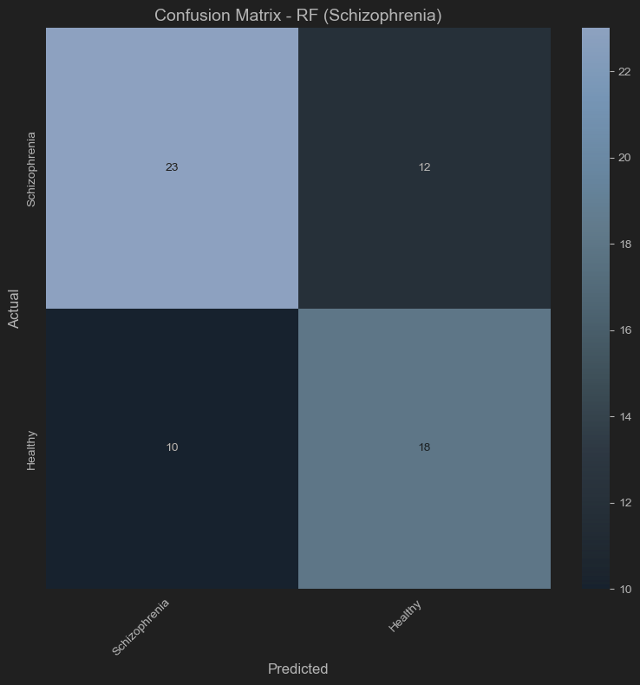
Schizophrenia vs Healthy
Accuracy:
68.1%
Better balance

Slide 24
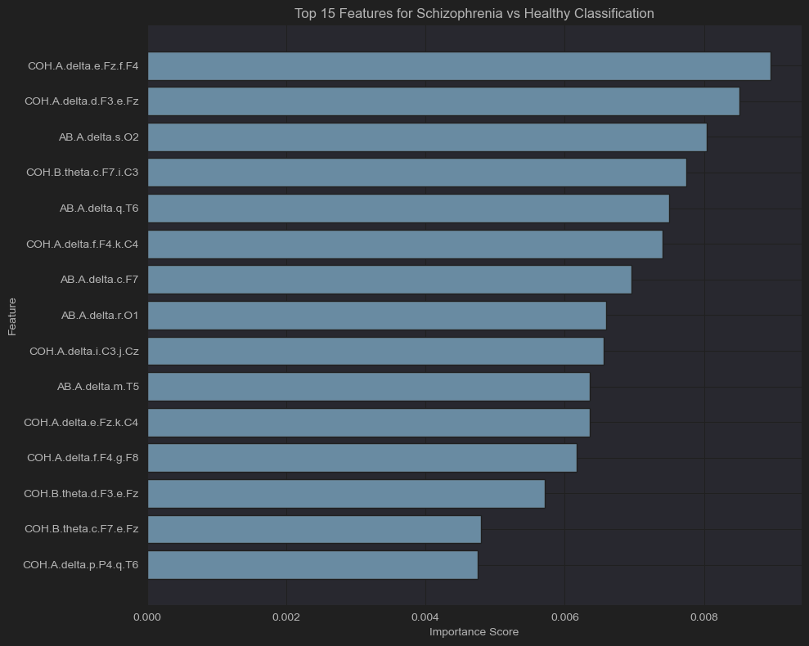
Feature Importance
Delta Power (AB) / Delta Coherence
Widespread slow-wave abnormalities

Slide 25
Summary
Distinct Signatures
Schizophrenia | Delta Power / Coherence Widespread
Mood Disorder | Delta + Alpha / Coherence Temporal-Parietal
Anxiety Disorder | Delta + Theta / Coherence Frontal
Addictive Disorder | Delta + Theta + Beta / Coherence Temporal-Frontal
Obsessive Compulsive Disorder | Delta + Beta + Gamma / Coherence Frontal (But the model was detecting healthy people)
Trauma and Stress Related Disorder | Delta + Beta + Gamma + Frontal Alpha / All Frequencies Widespread

Slide 26
Real world comparison
There are more factors (Such as IQ which I dropped so I could use raw EEG data)
After comparing my data to other clinical research, the data aligned well. However, due to overlapping symptoms for conditions and how little we still understand about the brain, a model like this could only be used as a supportive tool.
I also found a source that agreed that using binary classification is much better than multi-classification Loo et al. (2016)

Slide 27
Time/Limitations
If I had more time I would rework everything with another dataset to see how they compare. EEGs are very sensitive devices, and as such need to be properly handled for good data.
I would work with specific disorders, for example I used the main disorders such as Mood Disorder instead of specifically using diagnosed depression.
The brain is super complex, and we are still trying to understand a lot about it. There is so much complexity to mental health and the brain, so we may never get it perfect, but clinical diagnosis currently relies on symptoms and testimony, not biomarkers like EEG data.

Slide 28
References
https://nhahealth.com/brainwaves-the-language/
https://www.kaggle.com/datasets/shashwatwork/eeg-psychiatric-disorders-dataset/data
https://slidesgo.com/brain
https://scikit-learn.org/stable/index.html
https://pmc.ncbi.nlm.nih.gov/articles/PMC10068296/
https://pmc.ncbi.nlm.nih.gov/articles/PMC9633055/
https://www.journalmc.org/index.php/JMC/article/view/532/266
https://pmc.ncbi.nlm.nih.gov/articles/PMC12592092/
https://www.eneuro.org/content/7/4/ENEURO.0053-20.2020
https://pmc.ncbi.nlm.nih.gov/articles/PMC9331184/
https://sapienlabs.org/mentalog/schizophrenia-a-metaanalysis-of-resting-state-eeg-studies/

Slide 29

Slides template was taken from royalty free website. I am not an artist!

